Slide 1
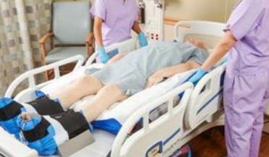
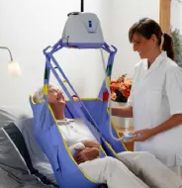
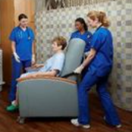
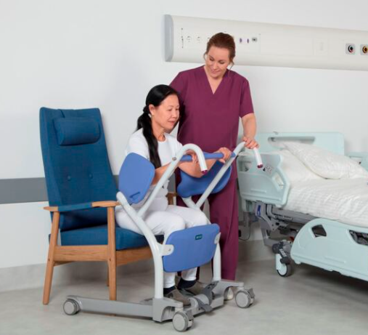
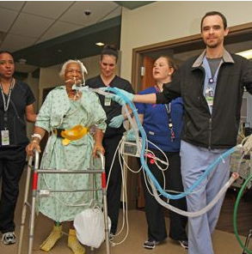
Pressure Injury Prevention and the Impact of Early Mobility Brianne Patenaude BSN, RN, WTA Cheryl Waldron MSN, RN, CCRN, WTA

Slide 2
Objectives
Explain the financial impact of pressure injuries
Review anatomy and physiology of skin structure
Describe the etiology and risk factors
Discuss the use and myths of Braden
Explain the etiology of friction, shear and moisture
Explain the impact of moisture management and support surfaces
Discuss the impact of Safe Patient Handling Equipment to reduce friction and shear
Discuss the impact of early mobility

Slide 3
Financial Impact
2.5 million patients are treated yearly
Cost to treat can range form anywhere 9.1 to 15 billion per year
Approximately 60,000 deaths a year are due to complications
Associated with increased health complications, deaths, length of
stay, and healthcare costs
More than 17,000 lawsuits annually
It is the second most common claim after wrongful death and is
greater than falls or emotional distress
AHRQ, 2011 & 2017

Slide 4
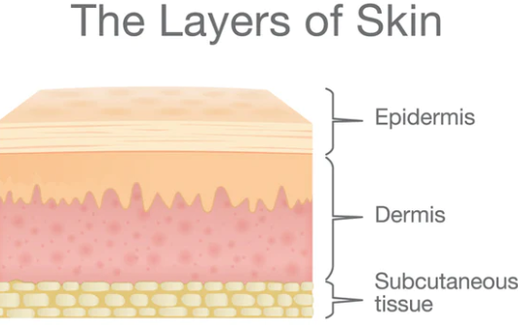
Anatomy and Physiology
Skin structure
Largest organ in the human body
Functions of the skin: thermoregulation, insulation, protection against microorganisms entering the body by maintaining a barrier between internal and external environments
In aging skin, structure changes occur- like a decrease in elastin and collogen production.
Epidermal thickness also decreases.

Slide 5
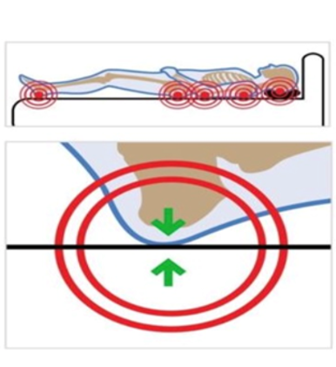
Etiology
Localized injury to the skin or underlying tissue
A result of intense or prolonged exposure or pressure in combination with shear
Usually over a bony prominence or related medical device
Can present as intact (unbroken skin or an open wound
Can be painful

Slide 6
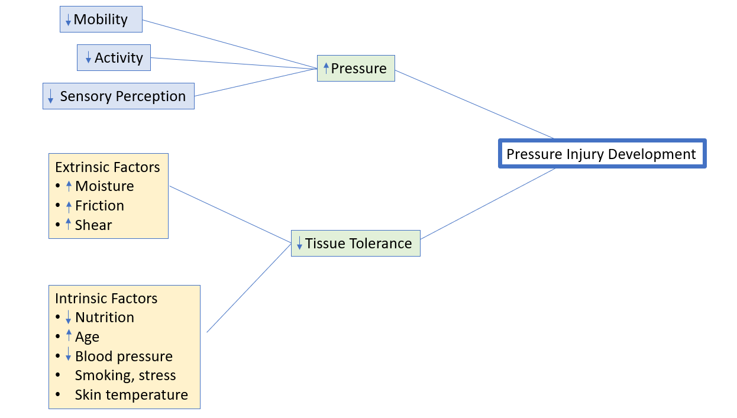
Risk Factors
Bryant & Nix, 2023
Notes:
Factors that can contribute to pressure injury development . Critically ill (LOS, Mechanical ventilation, use of vasopressors

Slide 7
Tools to identify patient at high risk for pressure injury

Slide 8
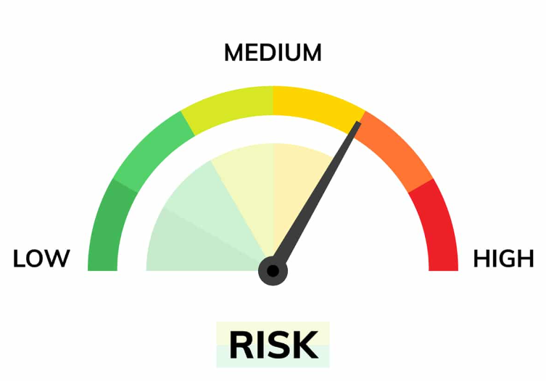
Braden Scale ©
Most widely used tool
Best validity and reliability
Assess 6 risk factors:
1. Mobility
2. Activity level
3. Sensory perception
4. Exposure to moisture
5. Nutrition status
6. Friction and Shear

Slide 9
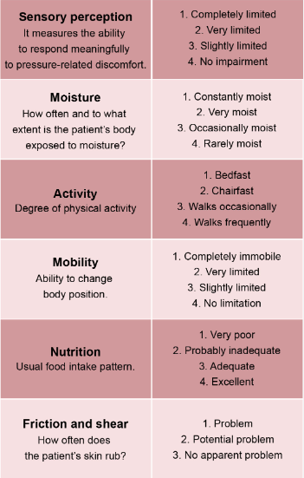
Braden Subscales ©
Not at risk > 18
Mild risk 15-18
Moderate risk 13-14
High risk 10-12
Very high risk ≤ 9
Bryant & Nix, 2023

Slide 10
Braden Scale ©

Slide 11
MYTH #1
Pressure injury prevention plan is based on the total score alone

Slide 12
Pressure injury prevention care plan is not based on the total score alone.
Consider subscale scores
Additional patient risk factors
Clinician judgement
This will serve as more of an accurate guide

Slide 13
MYTH # 2
Patients who are
agitated and moving
frequently do not have
a mobility deficit

Slide 14
Patients who are agitated and moving frequently may still have a mobility deficit
Movements are not purposeful or controlled

Slide 15
MYTH # 3
Patients who are restless or agitated commonly create friction on their elbows and heels

Slide 16
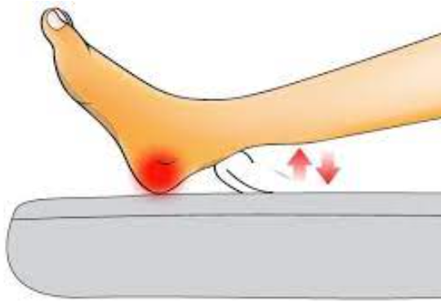
TRUE!!
Patients who are restless or agitated commonly are creating friction to the elbows and heels from the constant movement and rubbing against the bed surface

Slide 17
Friction and Shear

Slide 18
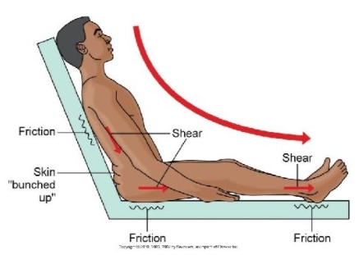
What is Friction ?
Friction occurs when skin rubs against an external surface
Continuous or repetitive movement. Rubbing or sliding of a material
Result can be redness, inflammation, or a friction blister

Slide 19
What is Shear ?
Shear is the mechanical force that acts on an area of the skin in a directional parallel to the body's surface
Affected by the amount of pressure exerted
Shearing forces cause one layer of tissue to move in relation to one or more of the other layers

Slide 20
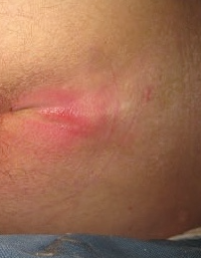
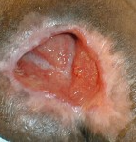
Friction/shear injury

Slide 21
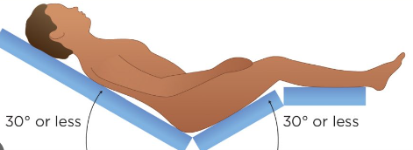
How can we reduce friction/shear?
Head of bed 30 degrees or below
Flexing knees by elevating foot of bed or placing pillows
Placing pillows under arms helps reduce sliding
Utilizing prophylactic foam dressings to the sacrum
Utilizing Safe Patient Handling Equipment

Slide 22
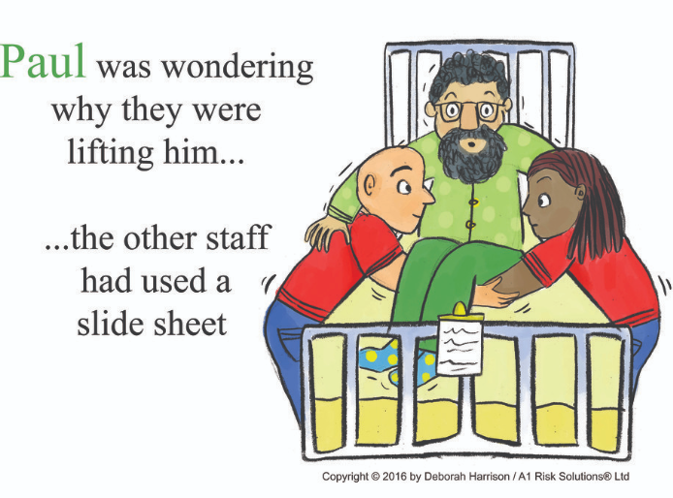
Types of patient transfers cause friction/shear injuries
Bed boost
Bed to chair
Wheelchair to chair
Wheelchair to toilet
Wheelchair to shower chair
Car to wheelchair
“Avoid dragging”

Slide 23
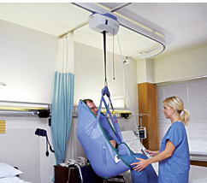
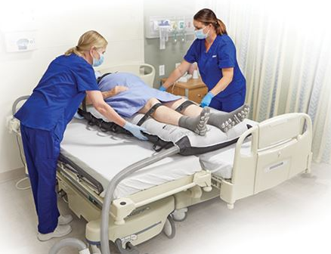
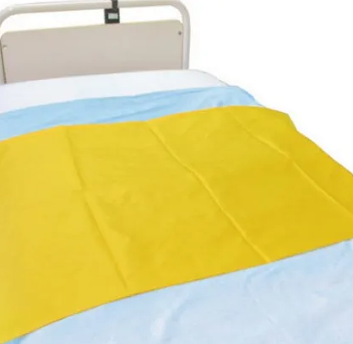
Equipment to reduce friction and shear
Ceiling and floor lifts: eliminate the need to slide patients from one surface to another
Air transfer system utilizes an air-filled mattress to aid in lateral transfers and repositioning
Slide sheets: a tubular, slippery sheet utilized for lateral transfers and repositioning

Slide 24
Moisture Management

Slide 25
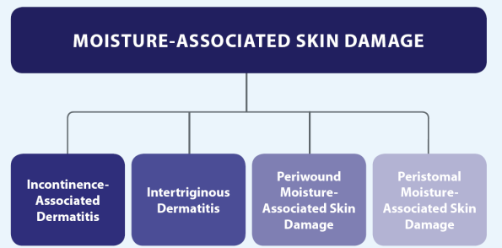
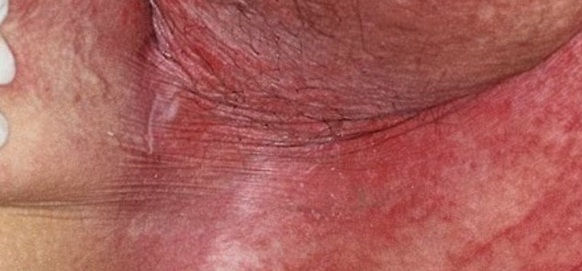
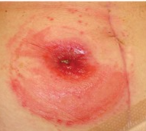
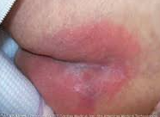
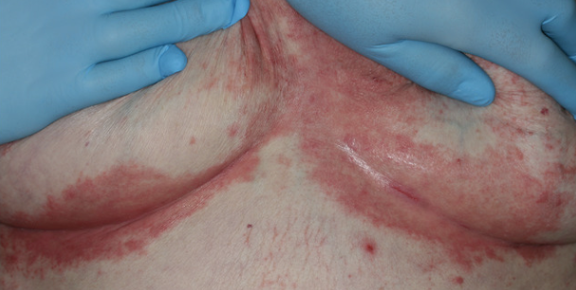
Types of Moisture

Slide 26
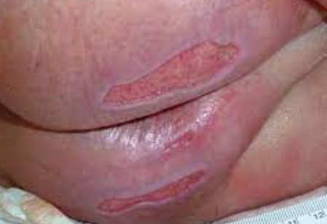
Moisture Management
Moisture can contribute to the development of pressure injuries
Keeping skin clean, dry, and supple is an important factor in pressure injury prevention
Controlling moisture through a low air loss surface, moisture barrier creams, moisture wicking fabric/ pads

Slide 27
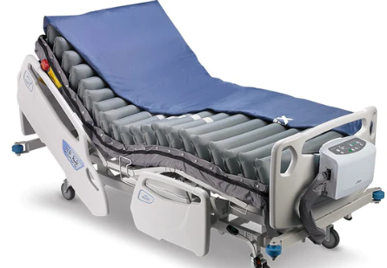
Support Surfaces
A specialized device for pressure redistribution designed for management of tissue loads, moisture control, microclimate, and/ or therapeutic functions
Help in prevention of pressure injuries by cushioning vulnerable body parts, redistributing body weight, and managing microclimate
Support surfaces alone do not prevent pressure injuries, but assist in prevention when utilized as part of a bundle

Slide 28
Types of support surfaces
Air Fluidized
Active/
alternating
Low air loss
Reactive
Continuous Lateral rotation
Contraindications: unstable spine, cervical or skeletal traction

Slide 29
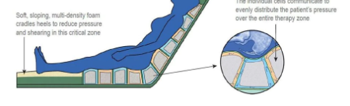
Reactive surfaces
Powered or non powered
Combination of foam and air
The support surface moves or changes its load distribution properties in response to an applied load, like the patient's body

Slide 30
Low air loss
Provides airflow to assist in managing heat and humidity of the skin.
Composed of a series of connected pillows.
Continuous airflow is provided by a pump

Slide 31
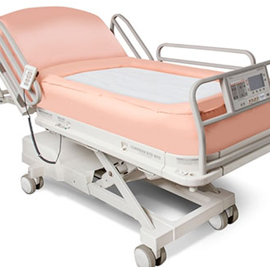
Air Fluidized
Air fluidized: air is forced through a granular medium, such as silicone-coated beads, producing a fluid state.

Slide 32
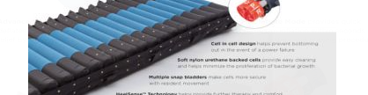
Active/Alternating
Power mattress or overlay that changes its load distribution properties with or without an applied load
For high-risk patients when frequent repositioning is not possible

Slide 33
Mobility

Slide 34
Mobility
Mobility refers to the patient’s ability to change and control their body position
Most often confused with activity subscale (i.e., getting up in the chair)
Score is determined by what the patient can self demonstrate

Slide 35
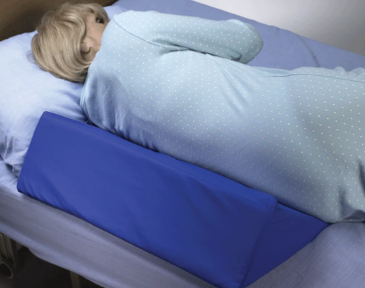
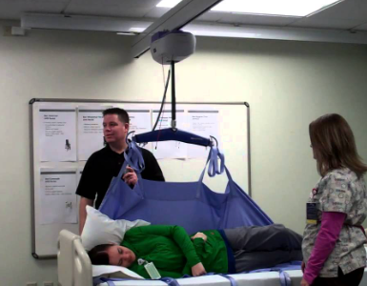
Routine Repositioning
Manually moving a patient into another position
to alleviate and redistribute pressure
30-degree lateral positioning
Although patient specific, patients should be
repositioned every 2-4 hours
Turning slings
Position wedges

Slide 36
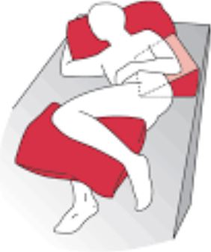
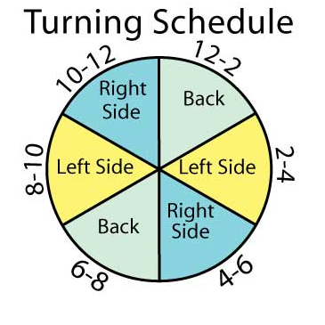
Proper turn technique
Placing the patient in a 30-degree side-lying
position with a pillow between the legs
Patient should be turned right side, left side, back

Slide 37
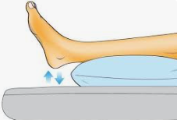
Floating/Offloading Heels
Prevent heel contact on bed surface
Posterior heel has only a thin layer of fat
Prophylactic dressings to prevent PI and friction/shear
Moisturize skin to prevent dryness
History of diabetes or vascular disease, increase risk of PI to heels due to decreased perfusion and sensation (neuropathy)

Slide 38
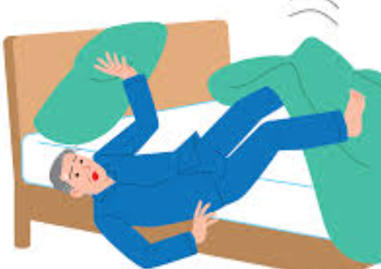
Impact of Immobility
Pressure Injuries
Deep Vein Thrombosis (DVT)
Pneumonia
Increased falls, muscle atrophy
Increased morbidity & mortality
Increased length of hospital stay
Increased hospital costs
Burden to the healthcare system

Slide 39
Bed Rest is BAD!!
Leads to a host of problems
“3-11% of muscle strength and tone can be lost in as little as one day”
“During the hospital stay, patients spend 83%-95% of their time in bed”

Slide 40
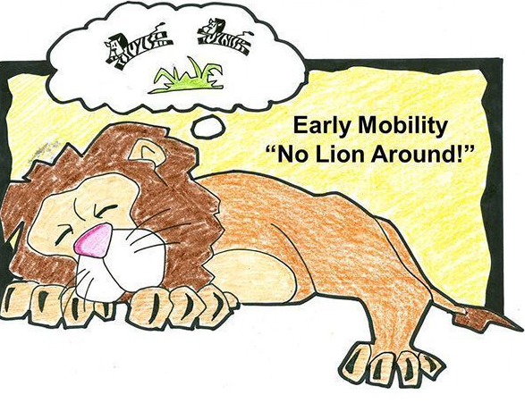
Early Mobility Benefits
Improve patient care outcomes
Decrease delirium
Decrease ventilator days
Decrease length of hospital stay, achieving a higher functional status at discharge

Slide 41
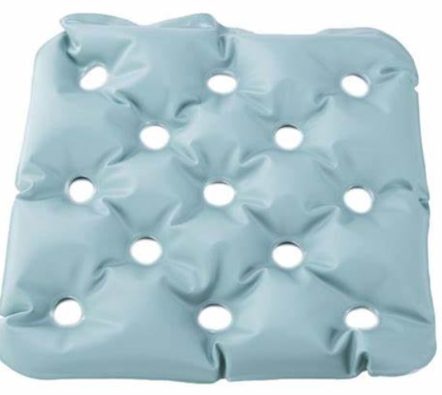
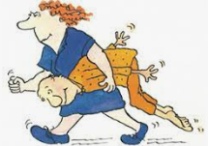
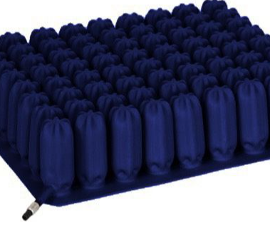
Pressure Injury Prevention continues with early mobility
Chair cushions can include foam, air, and gel.
Pressure redistribution chair cushions are recommended for all at risk patients
Ring or doughnut cushions should not be used for pressure injury prevention management

Slide 42
Safe patient handling and pressure injury prevention continue to collaborate and build a culture of safety

Slide 43
References
Agency for healthcare research and quality’s (ahrq) patient safety indicators (psis). Wachter R.M., & Gupta K(Eds.), (2017). Understanding Patient Safety, 3e. McGraw Hill. https://accessmedicine.mhmedical.com/content.aspx?bookid=2203&sectionid=170436437
Aguiar JR, de Oliveira Barbosa A, Galindo Neto NM, Ribeiro MA, Caetano JÁ, Barros LM. Risk factors associated to falls of hospitalized patients in medical-surgical clinics. Acta Paul Enferm. 2019;32(6):617-623. doi:10.1590/1982-0194201900086
Bryant, R., & Nix, D., (2023) Acute & Chronic Wounds Interprofessional From Novice to Expert St. Louis, Missouri: Elsevier
Growdon ME, Shorr RI, Inouye SK. The Tension Between Promoting Mobility and Preventing Falls in the Hospital. JAMA Intern Med. 2017;177(6):759. doi:10.1001/jamainternmed.2017.0840
Young D, Kudchadkar SR, Friedman M, et al. Using Systematic Functional Measurements in the Acute Hospital Setting to Combat the Immobility Harm. Archives of Physical Medicine and Rehabilitation. 2022;103(5):S162-S167. doi:10.1016/j.apmr.2020.10.142

