Slide 1
SPHM Benchmarking and Measurables
Presented By:
Chris Craigmile, CSPHP

Slide 2
Continuing Education Financial Disclosure Statement
Christopher Craigmile, CSPHP works with the following entities as a Consultant, Representative, Trainer/Educator or in other financial capacities.
HoverTech/HoverMatt
InoviHealth
HandiCare
LiftSeat
Inspire Outcomes
Nozin
ETAC/MoLift
DermaClip
The information within this presentation does not promote the usage of, or speak specific to, any of the fore mentioned relationships specific products. None of the presenters partnerships are paying for inclusion in said presentation.

Slide 3
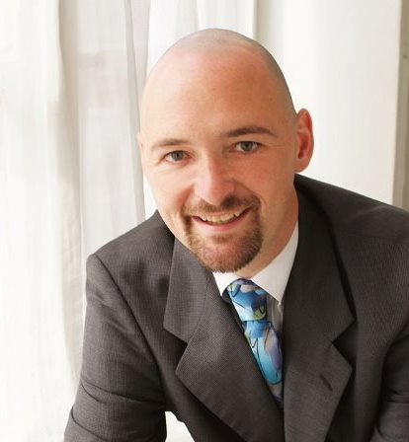
Assessors Biography
Chris Craigmile is a Certified Safe Patient Handling Professional primarily focused in Acute and Long-Term Healthcare settings and has spent the last 13 years developing, implementing and supporting Safe Patient Handling Programs across Upstate New York. Chris is highly sought-after consultant for Safe Patient Handling and Mobility (SPHM) risk assessments include attending to the environmental impacts that either obstruct or promote the safe movement of patients. He presently sits on several safe patient handling committees, architectural committee and educational programs. He is an active member with the Association of Safe Patient Handling Professionals, on the executive committee for SPHM certification, on the Certification Exam Committee and an educator and trainer specializing in SPHM. He is the co-founder and organizer of the annual NYS SPHM Summit held in Utica, NY with attendances reaching over 150 SPHM professionals from across the country.
This year he is launching two new division as part of Craigmile Health Solutions, SPH in EMS and SPH in Mortuaries.
Presentations:
Key Elements to Developing, Implementing and Managing SPHM Programs
Building the Business Case, Benchmarking and Creating Compliance
Integrating Ancillary Departments
Understanding the NYS Safe Patient Handling Act
SPHM Equipment Decision Making
SPHM in Architecture
The Bariatric Patient and pathways from Admission to Discharge
SPHM and OR protocols
The Impact of SPHM on Infection Prevention and Wound Care
Notes:
Architecture Commitees

Slide 4
Objectives
At the conclusion of the program, participants should be able to:
Describe SPHM Benchmarking and Measurables
Data Collection/Incident Reporting
Historical Data
Utilizing Information and Program Development
Provider approved by the California Board of Registered Nursing, Provider # 17497, for one (1) Contact Hour

Slide 5
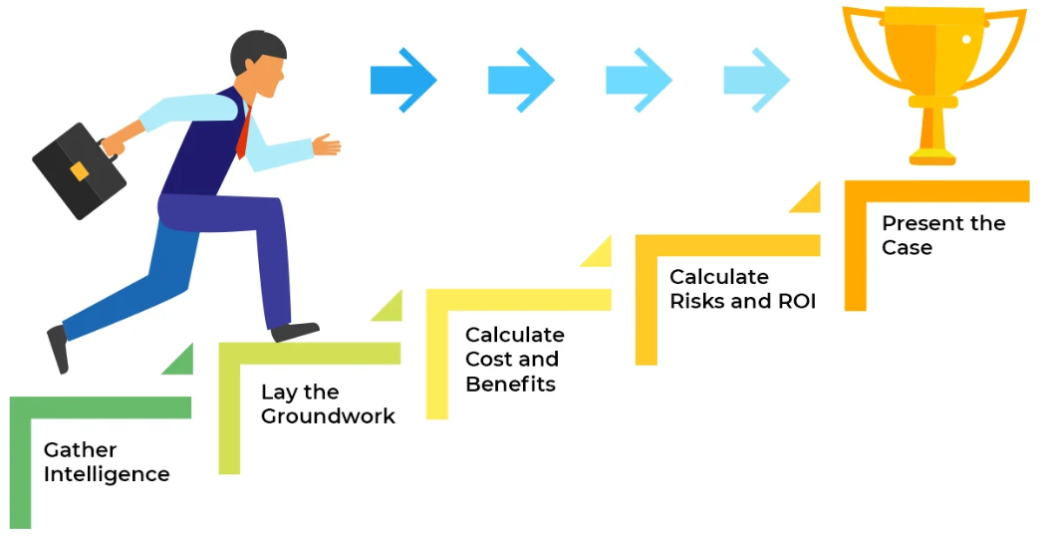
Developing the Business Case
Why do we need a benchmarking and measurables?
The Business Case!
Why the business case?
Show me the MONEY!!!
Measurables
Cost Avoidance/ROI
Allocation of resources
Gap analysis
Strategies for success
SWOT
The Risk Assessment…
Why 50% of our programs AREN’T Successful…

Slide 6
Benchmarking and Measurables
What is Benchmarking-
Safety professionals often want to compare, or benchmark, the occupational injury and illness incidence rates of their organizations with national average rates compiled by the Bureau of Labor Statistics (BLS) through its annual Survey of Occupational Injuries and Illnesses.
First, Calculate Your Incidence Rates
The first step in benchmarking is to calculate the incidence rates for your organization. The basic formula is (N x 200,000)/EH, or the number of cases (N) multiplied by 200,000 then divided by the number of hours worked (EH) by all employees during the time period, where 200,000 is the base for 100 full-time workers (working 40 hours per week, 50 weeks per year). By referencing the data on your OSHA 300 log and using this calculator you can determine your organization’s injury and illness rates.
Total recordable cases: Use the total number of cases on your OSHA 300 log.
Cases with days away from work: Count cases with a check in column H of your OSHA 300 log.
Cases with job transfer or restriction: Count cases with a check in column I of your OSHA 300 log.
Other recordable cases: Count cases with a check in column J of your OSHA 300 log.
Number of hours worked: Total hours worked by all employees as reported on your OSHA 300A log under establishment information.
https://www.publichealth.va.gov/employehttps://injuryfacts.nsc.org/work/industry-incidence-rates/how-to-benchmark/

Slide 7
Benchmarking and Measurables
What is Benchmarking-
Benchmarking is comparing the present data to either national averages of industry leaders or historical data from within your own organization.
What are Measurables-
Those things we can measure, track, analyze and therefore change through an intervention of process, technology, training, etc.
WHY…
Clear and concise data allows for directing future decisions financially, education and training, resource allocation, policy development… everything in the development of your SPHM Program is based on data.
Your program will only be proven successful
based on the quality of the DATA you collect!
Notes:
Infection Prevention Collects everything
Wound collects HAPI’s

Slide 8
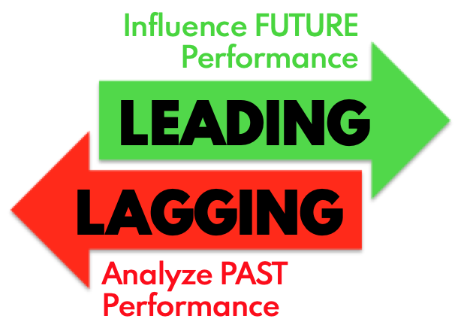
Benchmarking and Measurables
Leading Versus Lagging Indicators.
Put on your thinking caps…
List measurable indicators to document the success (or not) of your SPHM Program:
Notes:
Staff Injuries (career ending, loss/restricted, direct and indirect costs)- Falls- Wounds- patient Injuries- staff retention (detail, moral, job satisfaction)- length of stay- annual training and competencies- equipment usage (cycles, usage/repurchasing rates)

Slide 9
What Data?
Data is the WHO, WHAT , WHERE, WHEN, HOW & WHY.
Notes:
This is the senior level summary view of the impact of your present SPHM Program
What constitutes a career ending injury?

Slide 10
What Data?
Data is the WHO, WHAT , WHERE, WHEN, HOW & WHY.

Slide 11
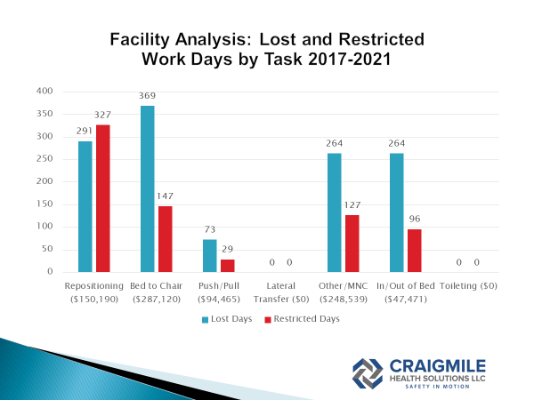
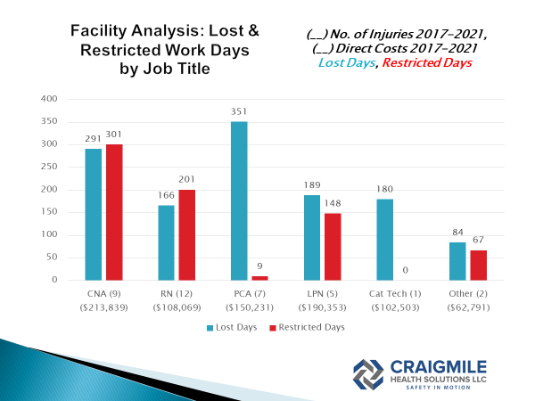
What Data?
Data is the WHO, WHAT , WHERE, WHEN, HOW & WHY.
Notes:
Frequency and Severity
Task/Position/

Slide 12
What Data?
Data is the WHO, WHAT , WHERE, WHEN, HOW & WHY.
Notes:
Perception is reality!

Slide 13
Historical Data & Tracking Document
Below are the key elements to collecting and tracking incidents to extrapolate where the best allocation of future resources would be, while at the same time benchmarking the success of interventions.
Year of incident
Case no. or identifier
Date of injury
Job Title
Dept/Unit/Household
Body Part Injured
Cause (task being performed)
Narrative/Detailed Description
Lost Days
Restricted Days
Medical Costs (Incurred and Reserve)
Carrier Ending

Slide 14
Historical Data & Tracking Document

Slide 15
Incident Reporting
To understand the impact of a SPHM program starts before an incident occurs. The incident reporting process, facility culture, root cause analysis (RCA), accountability to management all impact the quality of data collection.
Why do staff not report injuries/incidents and how do we overcome non-reporting?
Workers compensation
Culture
Guilt
Accountability/Policy
Incident reporting process
How soon after an SPHM incident should Risk and SPHM team be notified?
How long after an incident should the report be filed?
Paper or electronic?

Slide 16
Incident Reporting
Understanding what should be included on an incident report.
Time and date
Exact location (Rm number, unit/dept/house, facility)
Was the patient injured
Everyone involved and manager on duty
A FULL description of incident including;
Task
Equipment used
Injury(s)
Initial cause of injury
Immediate interventions

Slide 17
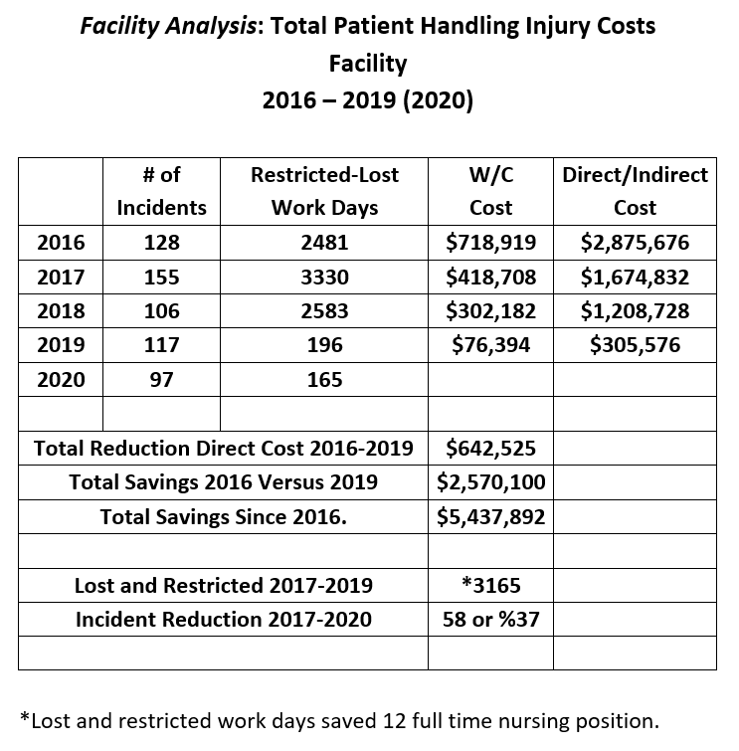
Data Provides Proof
What impact does SPHM Program have on your facilities bottom line!
Facility 1-

Slide 18
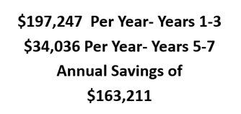
Calculating Cost Avoidance

Slide 19
Assessment Findings Facility 2 Cost of Summary of Direct and Indirect Costs Associated with your SPHM Program
Notes:
Chris

Slide 20
Lost and Restricted Work Days Facility 2
Lost and restricted workdays are a key measurement for severity of injuries.
Lost Workdays
Years 1-5, 462 days
Years 6-8,142 days
Restricted Workdays
Years 1-5, 63 days
Years 6-8, 43 days
Total reduction of 71%
Total reduction of 32%
Notes:
Chris

Slide 21
Career Ending Injuries Facility 2
In years 1-5 there were nine (9) career ending injuries due to SPHM Tasks.
In the following 3 years there was one (1) career ending injury due to SPHM Tasks.
Years 1-5 = 1.8 Careers lost annually
Years 6-8 = .25 Careers lost annually
Notes:
Chris

Slide 22
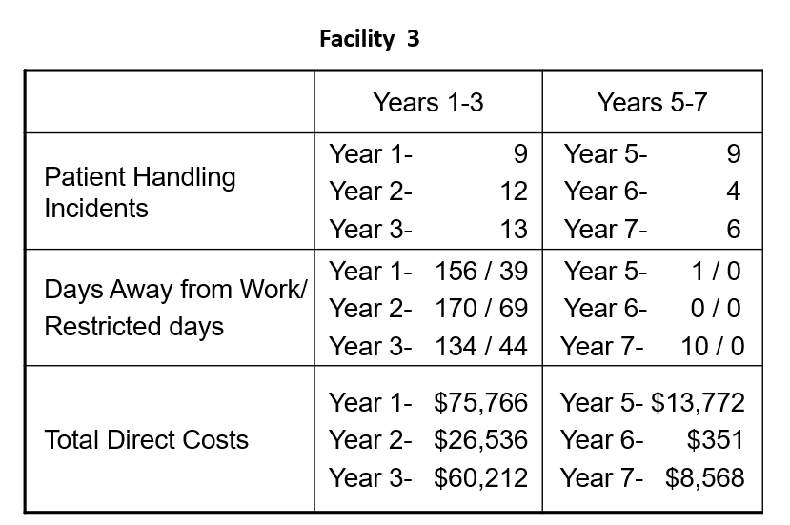
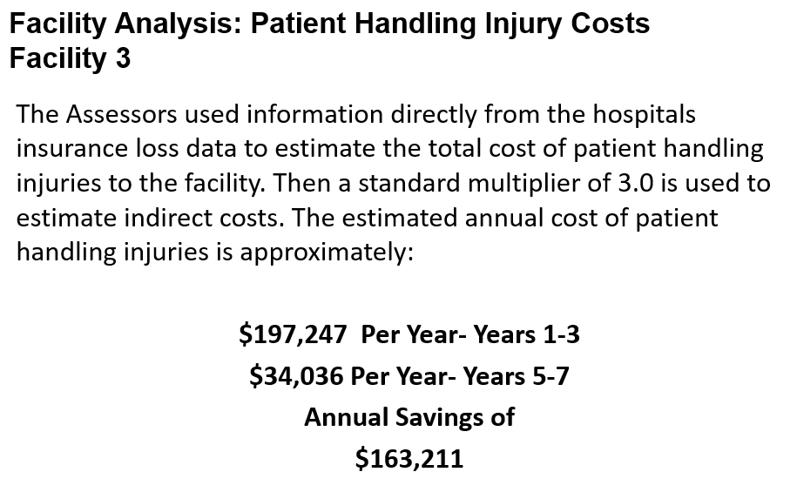
Facility 3

Slide 23
Other Measurables
There are a number of other areas that the SPHM Program impacts that can be measured including:
Staff retention
Reduction in falls
Reduction in HAPI’s
Reduced length of stay/better patient outcomes
Others?

Slide 24
Actions Moving Forward
Promote the utilization of your incident reporting system, make sure it works!
Work with your workers comp carriers and risk person to collect the historical key data
Identify the gaps in your SPHM Program
Evaluate costs to eliminate task, calculate savings opportunity then take business case to leadership
ASK FOR HELP!!!

Slide 25
Last Thoughts…
“Inspect what you expect!”
“What you permit, you promote.
What you allow, you encourage.
What you condone, you own.”

Slide 26
Thank You!
Chris Craigmile, CSPHP
Safe Patient Handling Consultant
Craigmile Health Solutions LLC
C-(315)955-5422
F-(855)750-2005
Chris@craigmilehealth.com

